Slide 1

A presentation
on
Drone Based Remote Sensing of Vegetation
by
Rahul Raj
Research Scholar CSRE, IIT Bombay IITB-Monash Research Academy

Slide 2
Types of farm data collected through Drones
RGB Images
Multispectral Images
Hyperspectral Images
Thermal Images
LiDAR data
Signals from ground sensors
Drones are also used for sprinkling pesticides in farms

Slide 3
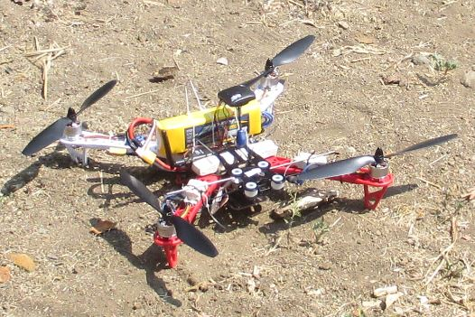
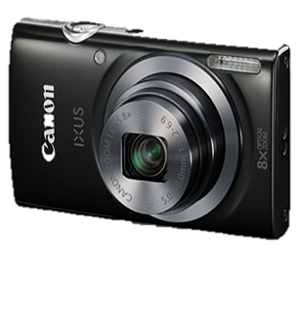
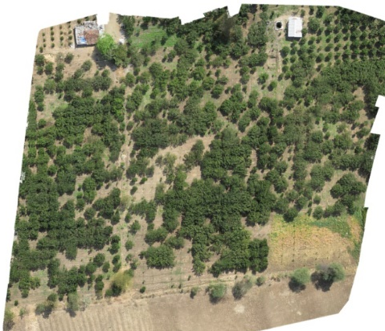
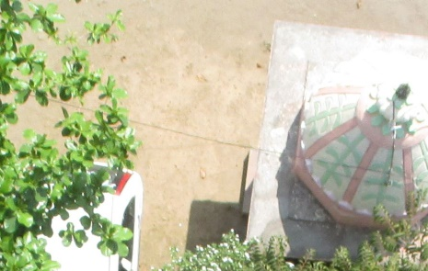
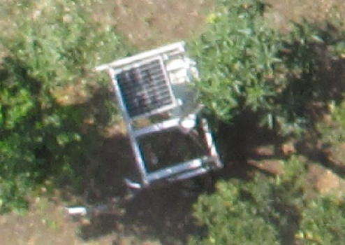
Types of farm data collected through Drones
RGB Images
Multispectral Images
Hyperspectral Images
Thermal Images
Lidar data
Signals from ground sensors
What are your objectives of data collection ???

Slide 4
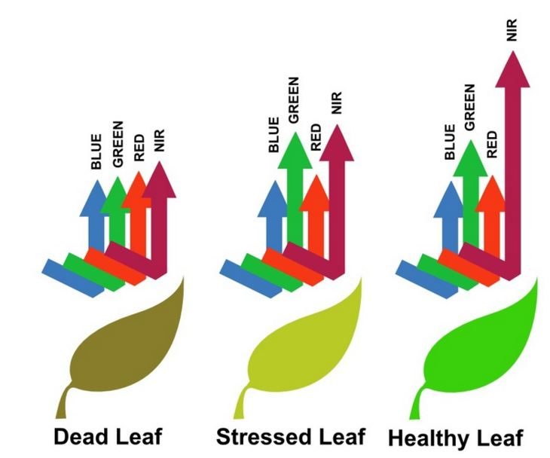
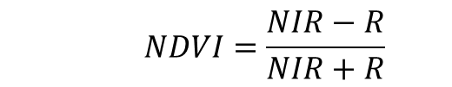
Types of farm data collected through Drones
RGB Images
Multispectral Images
Hyperspectral Images
Thermal Images
Lidar data
Signals from ground sensors
$$NDVI=\frac{NIR−R}{NIR+R}$$
Image source: Agribotix
Does this really works ???
What exactly you want to find with NDVI ?

Slide 5
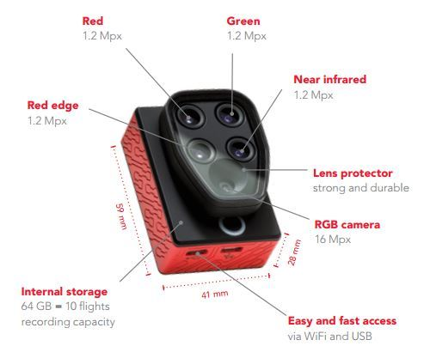
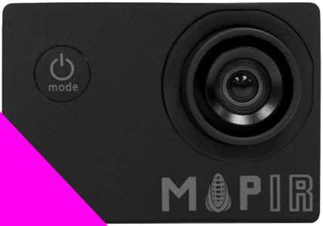
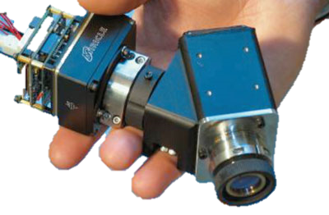
Types of farm data collected through Drones
RGB Images
Multispectral Images
Hyperspectral Images
Thermal Images
Lidar data
Signals from ground sensors
Multispectral Cameras
Source: http://www.mapir.camera/

Slide 6
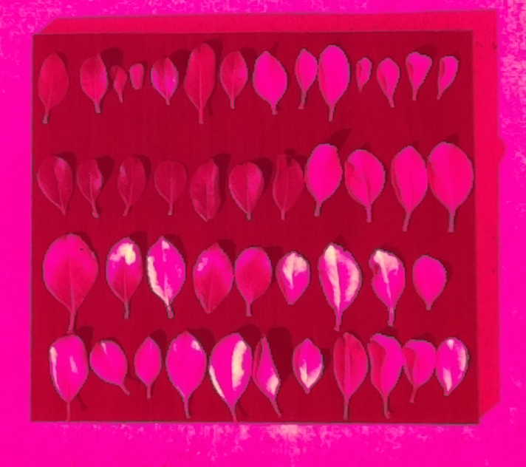
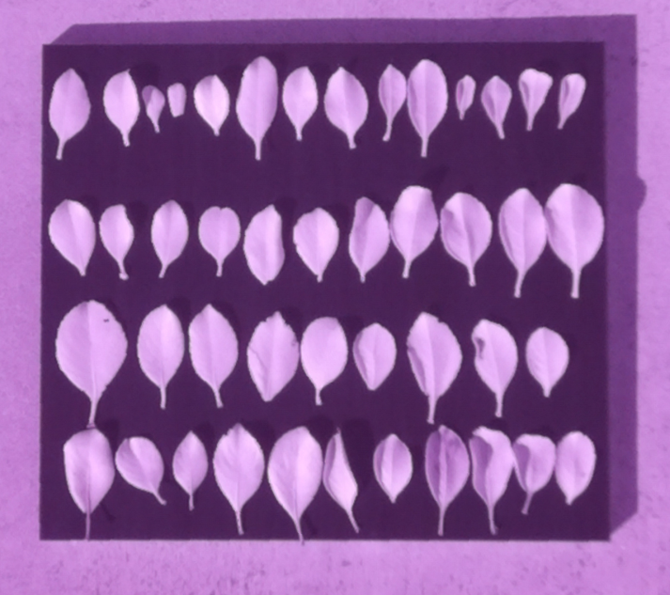
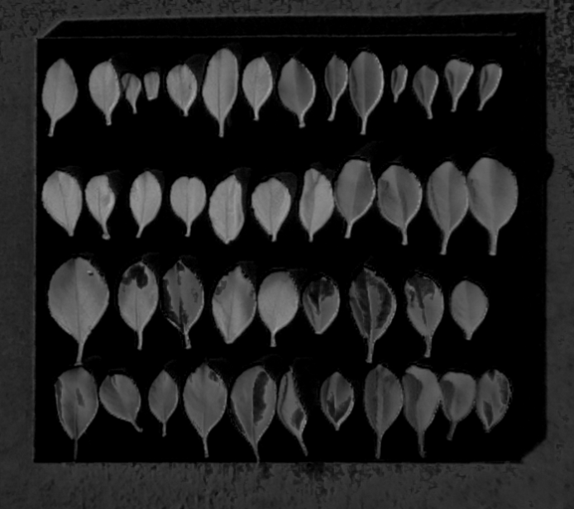
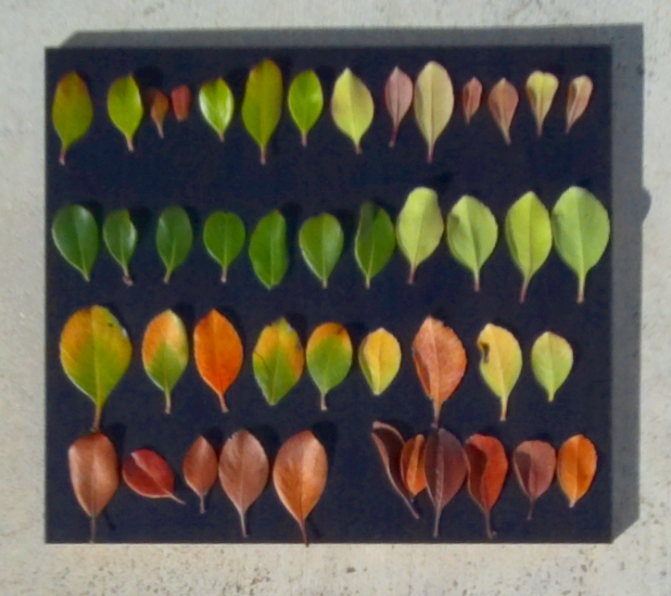
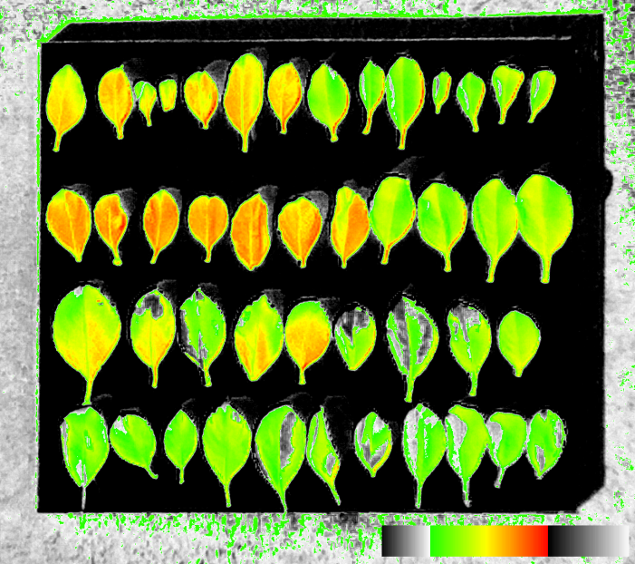
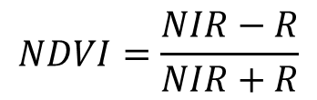
Normalized Difference Vegetation Index
$$NDVI=\frac{NIR−R}{NIR+R}$$
IR image 850 nm
Red band image 650 nm
NDVI image (No gradient)
NDVI image
(G=0.2, R=0.68)
RGB image
Source: http://www.mapir.camera/

Slide 7
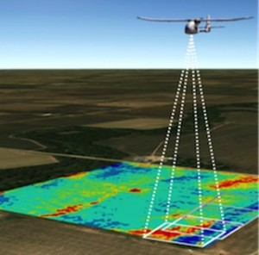
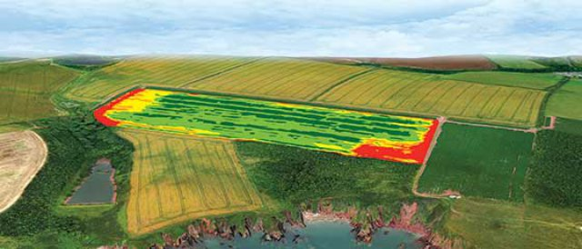
Types of farm data collected through Drones
RGB Images
Multispectral Images
Hyperspectral Images
Thermal Images
Lidar data
Signals from ground sensors

Slide 8
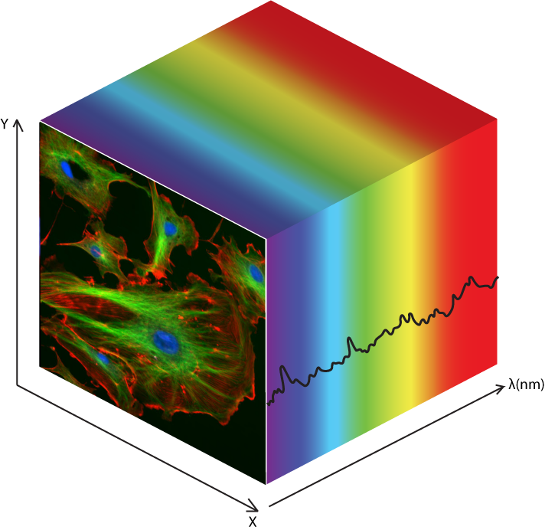
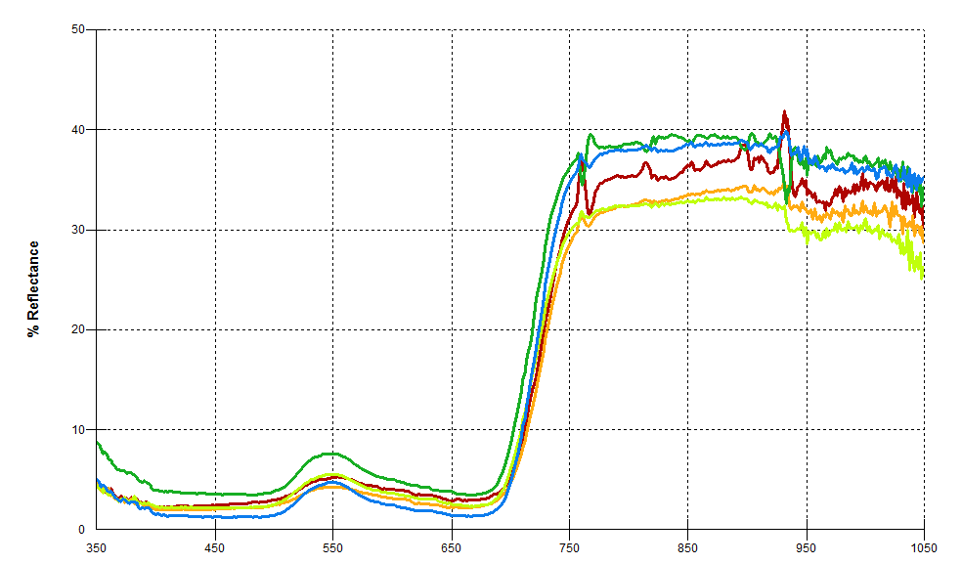
Types of farm data collected through Drones
RGB Images
Multispectral Images
Hyperspectral Images
Thermal Images
Lidar data
Signals from ground sensors
Hyperspectral Data cube
Hyperspectral signatures of vegetation

Slide 9
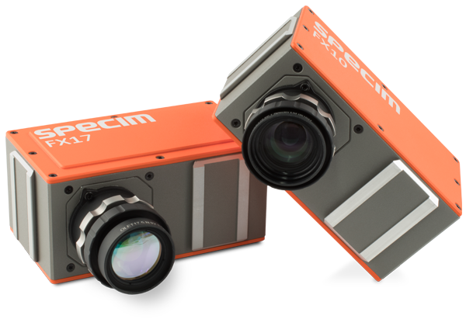
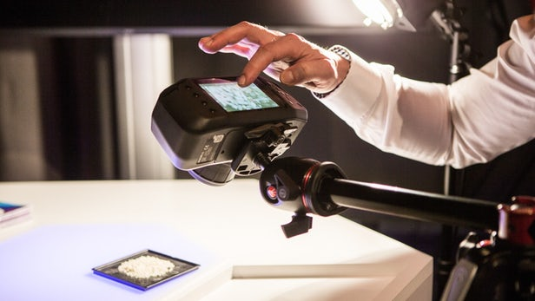
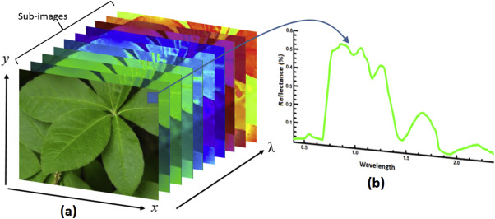
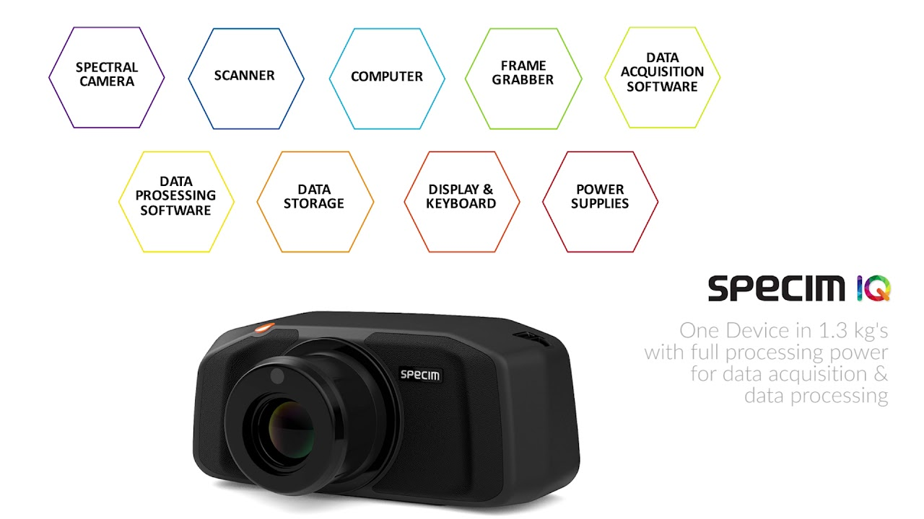
Types of farm data collected through Drones
RGB Images
Multispectral Images
Hyperspectral Images
Thermal Images
Lidar data
Signals from ground sensors

Slide 10
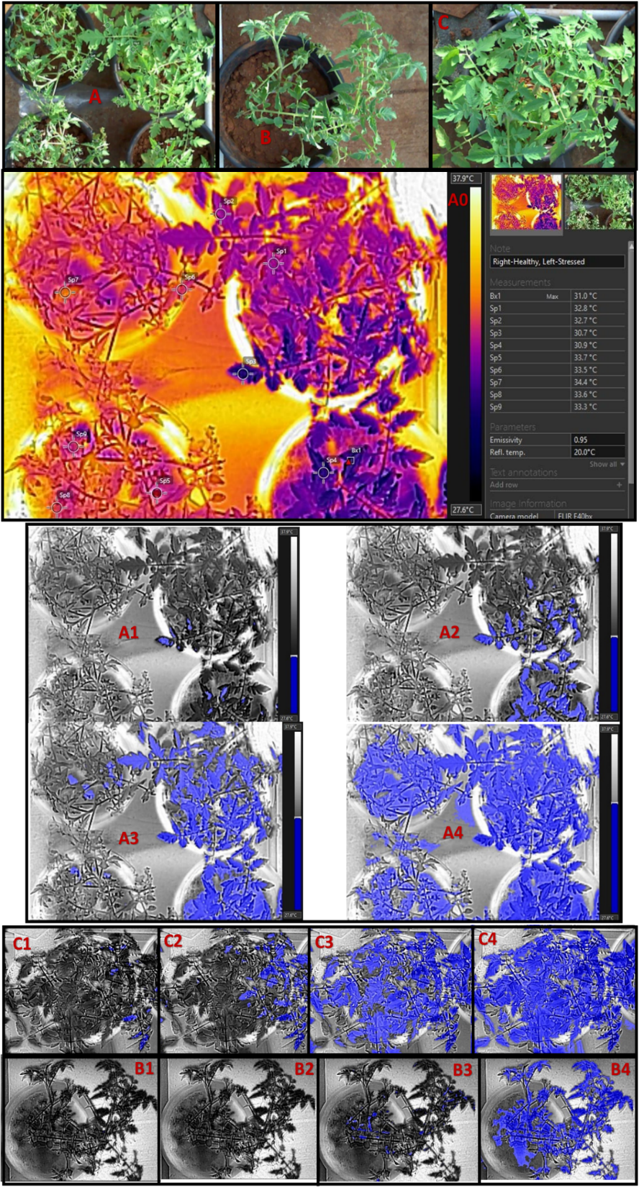
Types of farm data collected through Drones
RGB Images
Multispectral Images
Hyperspectral Images
Thermal Images
Lidar data
Signals from ground sensors
What are your objectives of data collection ???

Slide 11
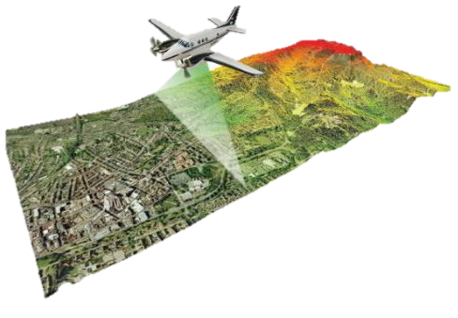
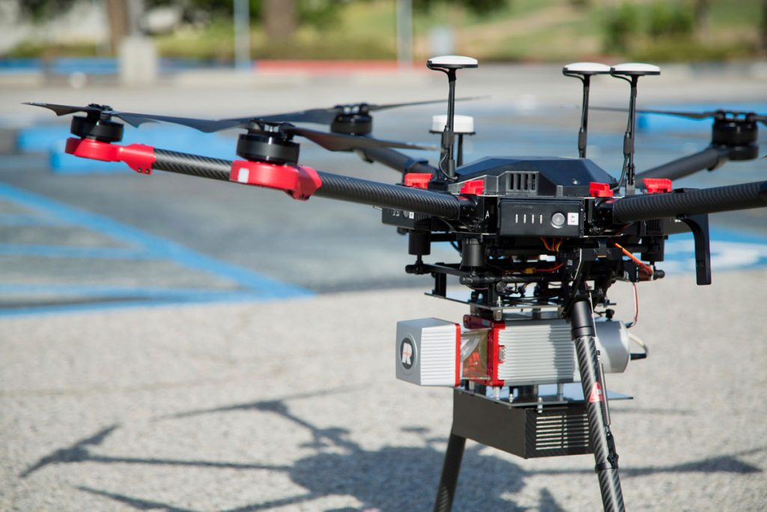
Types of farm data collected through Drones
RGB Images
Multispectral Images
Hyperspectral Images
Thermal Images
LiDAR data
Signals from ground sensors
Source: www.precisionhawk.com

Slide 12
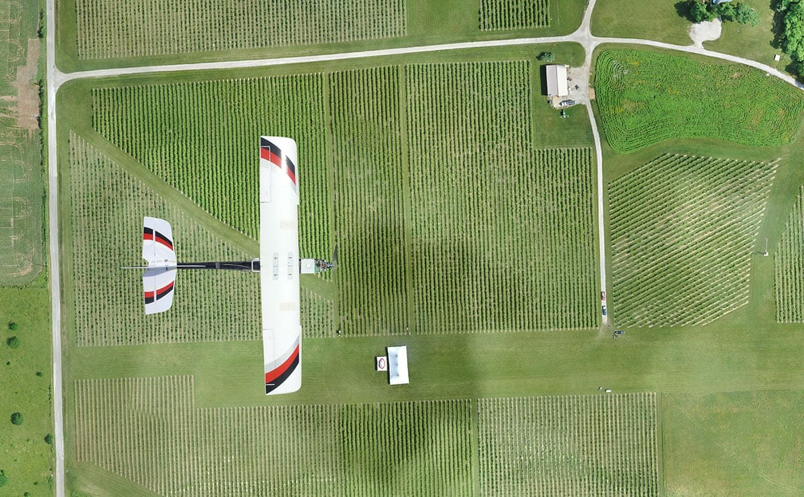
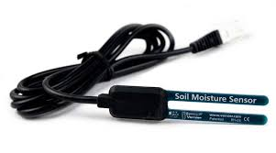
Types of farm data collected through Drones
RGB Images
Multispectral Images
Hyperspectral Images
Thermal Images
Lidar data
Signals from ground sensors

Slide 13
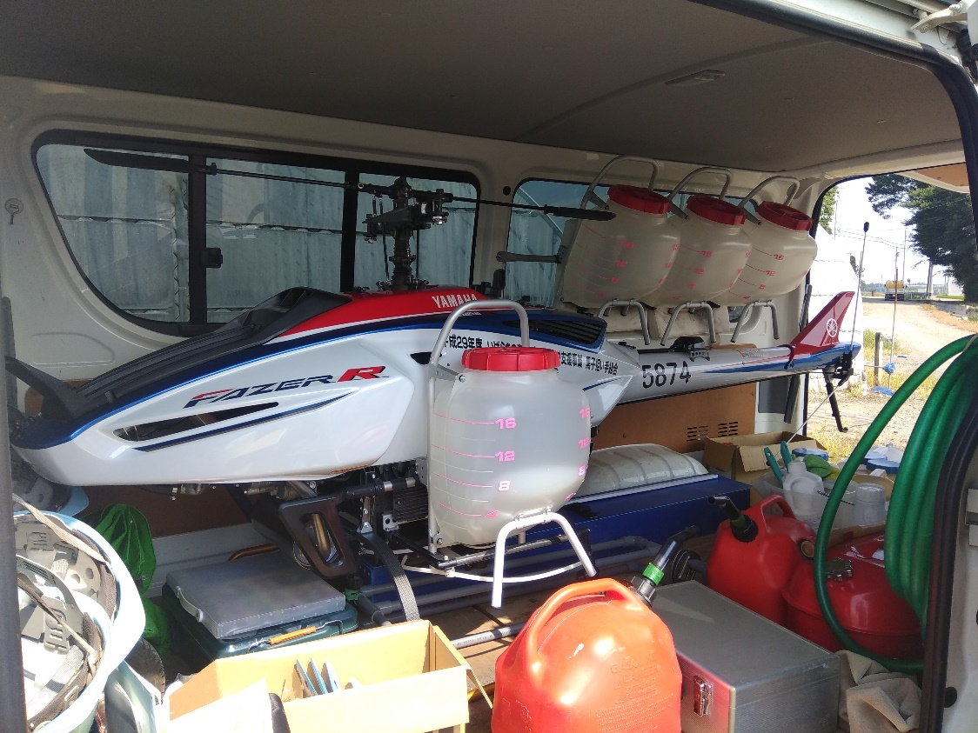
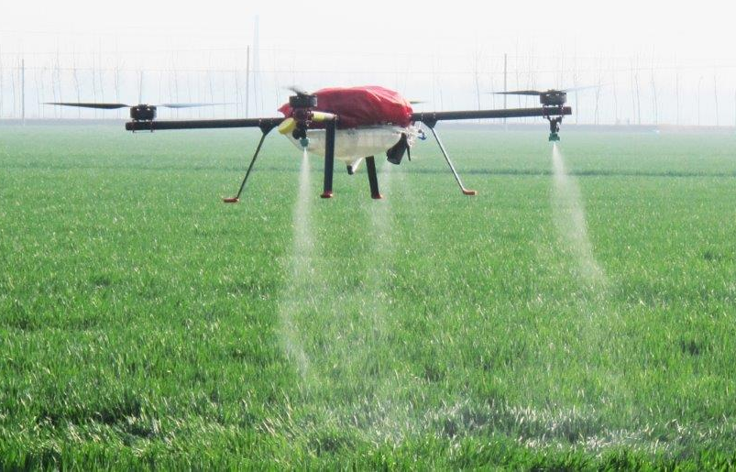
Types of farm data collected through Drones
RGB Images
Multispectral Images
Hyperspectral Images
Thermal Images
Lidar data
Signals from ground sensors
Drones are also used for sprinkling pesticides in farms

Slide 14
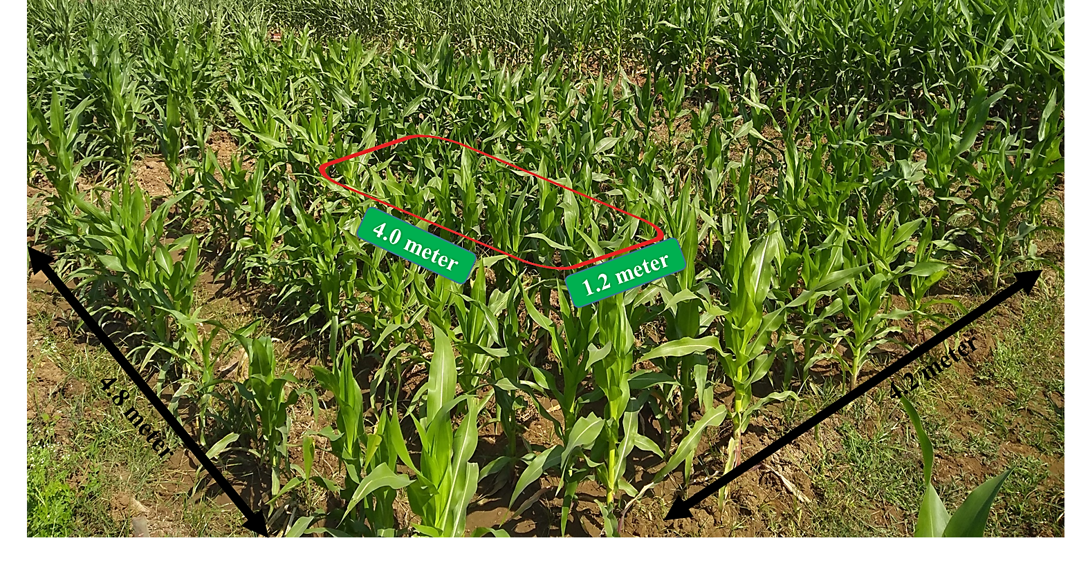
Assignment
Find LAI of given top-of-the-canopy drone Images. You can use canopy extinction coefficient value (K) as 0.5.
Note: Apart from Otsu’s method of image classification you can explore some other methods like Lab colour space or texture method or neural network. Do some exploration and bring it to AI lab.
There are 81 subplots of maize (with different treatments) as shown in figure. Because of research requirement you want to do height analysis of the plants. Due to time constraint, It is impossible for you to collect height of all the plants from all the subplots. What scientific method you will apply to decide minimum number of samples if you
can allow an error of 20 cm in your estimated height. (Accept that you want to be 95 % sure about your results)
Ask Questions…

